Slide 1

Chapter 10
Advanced Django Admin and Customizations

Slide 2

Objectives
This chapter introduces you to advanced customizations to the Django Admin site so that you can tailor the appearance of the Django Admin dashboard to make it blend with the rest of your web project.
These customizations are driven by the addition of custom templates that help modify the look and feel of existing pages.

Slide 3
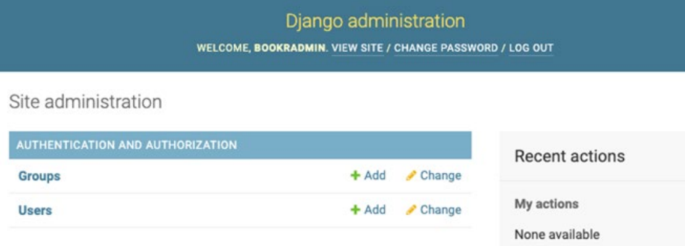
Introduction

Slide 4
Customizing the Admin Site

Slide 5
Discovering Admin Files in Django
When we build applications in our Django project, we use the admin.py file frequently to register our models or create ModelAdmin classes that customize our interactions with the models inside the admin interface.

Slide 6
Discovering Admin Files in Django
The discovery of these files is affected automatically by Django once we add django.contrib.admin to our INSTALLED_APPS section inside our settings.py file.

Slide 7
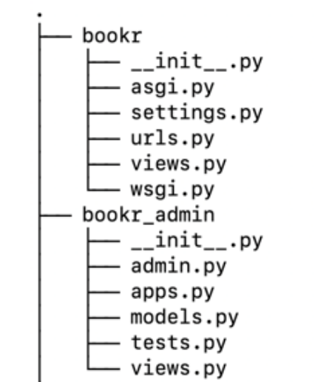
Discovering Admin Files in Django
When the admin application gets added, it tries to find the admin module inside every app of the Django project we are working on and, if a module is found, it loads the contents from that module.

Slide 8
Django's AdminSite Class
To provide us with the default admin site, Django packages a module known as the admin module, which holds a class known as AdminSite.
As we start to create our custom admin site, we will try to leverage the existing useful set of functionalities that are provided by Django's default AdminSite class.

Slide 9
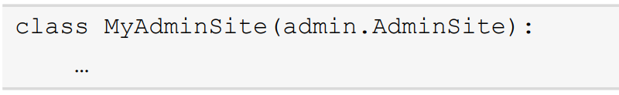
Django's AdminSite Class
For example, the following code snippet shows how we can create a child class of Django's AdminSite class.

Slide 10
Overriding the Default admin.site
We can avoid this additional burden by overriding the default admin.site property.
We first have to create a new AdminConfig class, which will override the default admin.site property for us, so that our application is marked as the default admin site and hence overrides the admin.site property inside our project.

Slide 11
Customizing Admin Site Text Using AdminSite Attributes
We can use the admin.site properties to customize the text for our Django application, we can also use the attributes exposed by the AdminSite class to customize these texts.

Slide 12
Customizing Admin Site Text Using AdminSite Attributes
site_header: Text to display at the top of every admin page (defaults to Django Administration).
site_title: Text to display in the title bar of the browser (defaults to Django Admin Site).

Slide 13
Customizing Admin Site Text Using AdminSite Attributes
site_url: The link to use for the View Site option (defaults to /). This is overridden when the site is running on a custom path and the redirection should take the user to the subpath directly.
index_title: This is the text that should be shown on the index page of the admin application (defaults to Site administration)

Slide 14
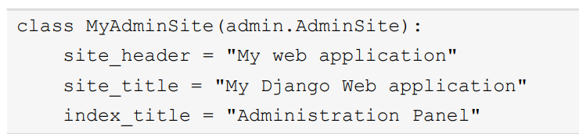
Customizing Admin Site Text Using AdminSite Attributes
If we want to override these attributes in our custom admin site, the process is very simple:

Slide 15
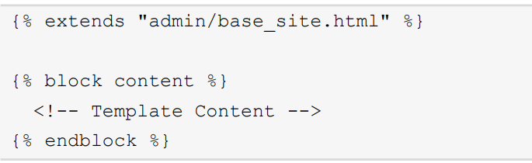
Customizing Admin Site Templates
For example, the following code snippet shows how we can add a new template to the Django admin dashboard.

Slide 16

Customizing Admin Site Templates
This can be done by using the template extension tags and extending the base_site.html template from the admin module provided by Django.

Slide 17
Adding Views to the Admin Site

Slide 18
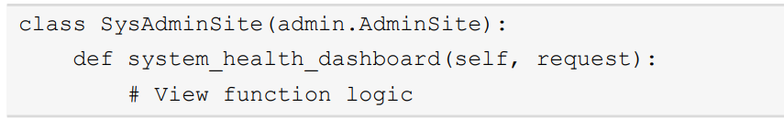
Creating the View Function
We can create a new view function named system_ health_dashboard() inside our custom AdminSite class implementation, as shown in the following code snippet.

Slide 19
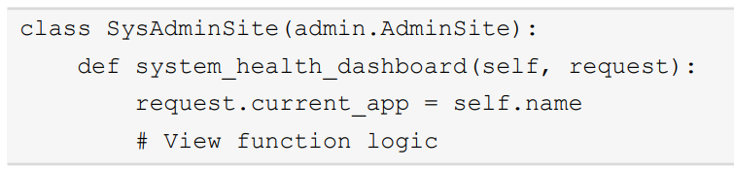
Creating the View Function
The self.name field is automatically populated by Django's AdminSite class and we don't need to initialize it explicitly.

Slide 20
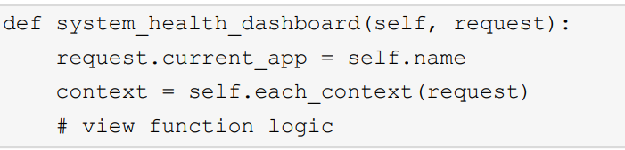
Accessing Common Template Variables
The each_context() method of the AdminSite class takes a single parameter, request.

Slide 21
Mapping URLs for the Custom View
If we would like to add a URL mapping for our custom view, the preferred approach includes overriding the implementation of get_urls() in our custom AdminSite class and adding the URL mapping there.

Slide 22
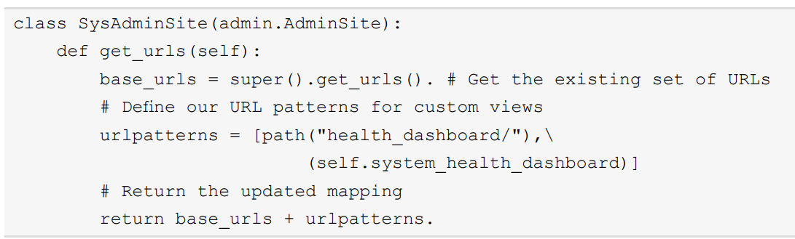
Mapping URLs for the Custom View

Slide 23
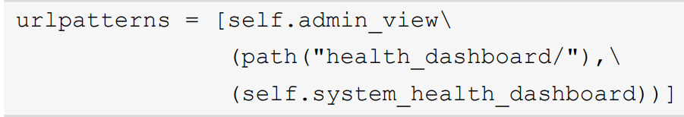
Restricting Custom Views to the Admin Site
If you followed all the previous sections thoroughly, you would now have a custom AdminSite view ready for use.

Slide 24
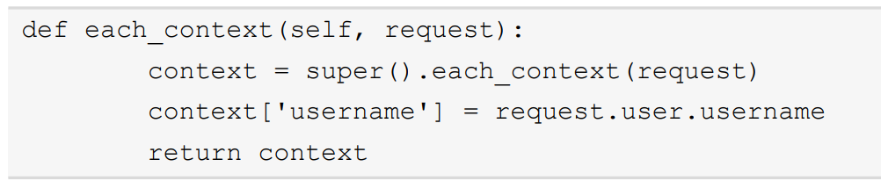
Passing Additional Keys To The Templates Using Template Variables
These template variables are prepared and returned by the AdminSite.each_context() method.

Slide 25
Summary
In this chapter, we looked at how Django allows the customization of its admin site.
We learned how to build a custom admin site by leveraging the concepts of object-oriented programming in Python and creating a child class of AdminSite.

